Slide 1
Misplaced/Suspicious Package Detection and Alert System
Mid-Project Status
Robert Kolaja, Albert Le, and Tony Wang

Slide 2
Project Overview
Suspicious package detection and alert system for public spaces such as airports and train stations
Alert staff via a remote management server [IoT]
May receive input from multiple instances of the detection device
Save and send video before and after a package is detected to the server for review

Slide 3
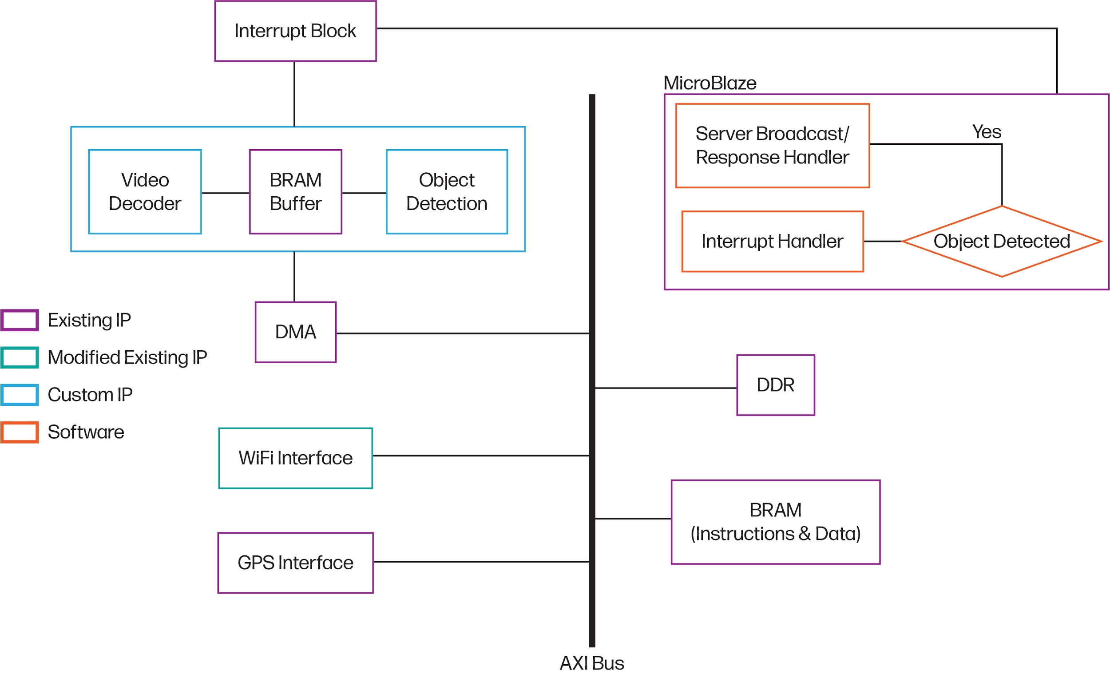
Original
Block
Diagram

Slide 4
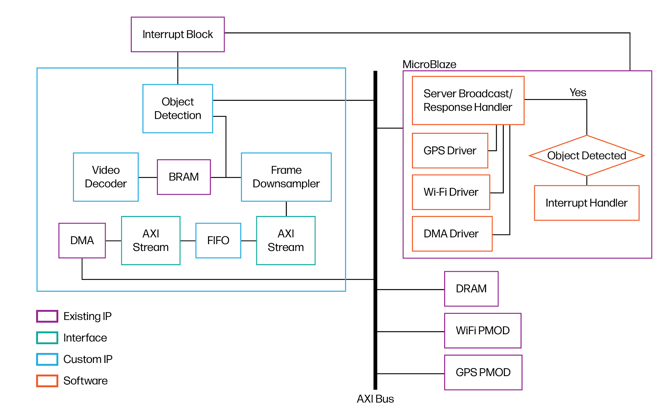
Updated
Block
Diagram

Slide 5
Object Detection Algorithm
Take an image of the unoccupied space where we would like to monitor for suspicious objects. Store this image as the reference frame
For every subsequent frame:
Compute the pixel-wise difference (XOR) between the current frame and the reference frame. Store this difference as the difference frame. This is to identify foreign objects not in the reference frame.
Compute the pixel-wise similarity (AND) between the current difference frame to the previous difference frame to look for objects that remain stationary in the video over successive frames.
A suspicious object is identified if: An object is detected in the current frame AND This object has remained stationary for a number of frames (several seconds)
Note: All frames are preprocessed to and stored as 1-bit black/white QVGA (320x240) frames

Slide 6
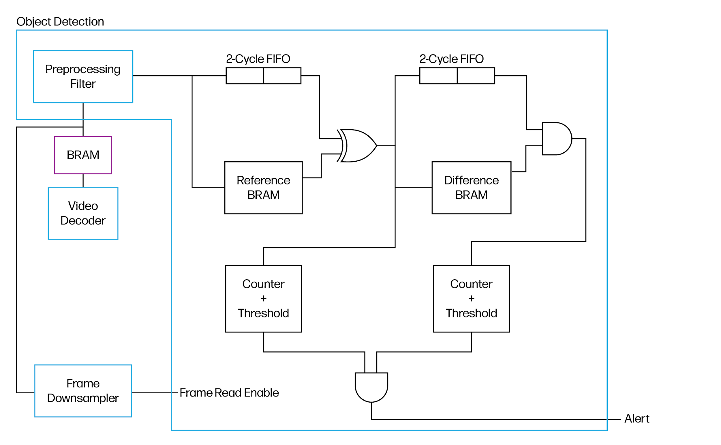
Object Detection
Block
Diagram

Slide 7
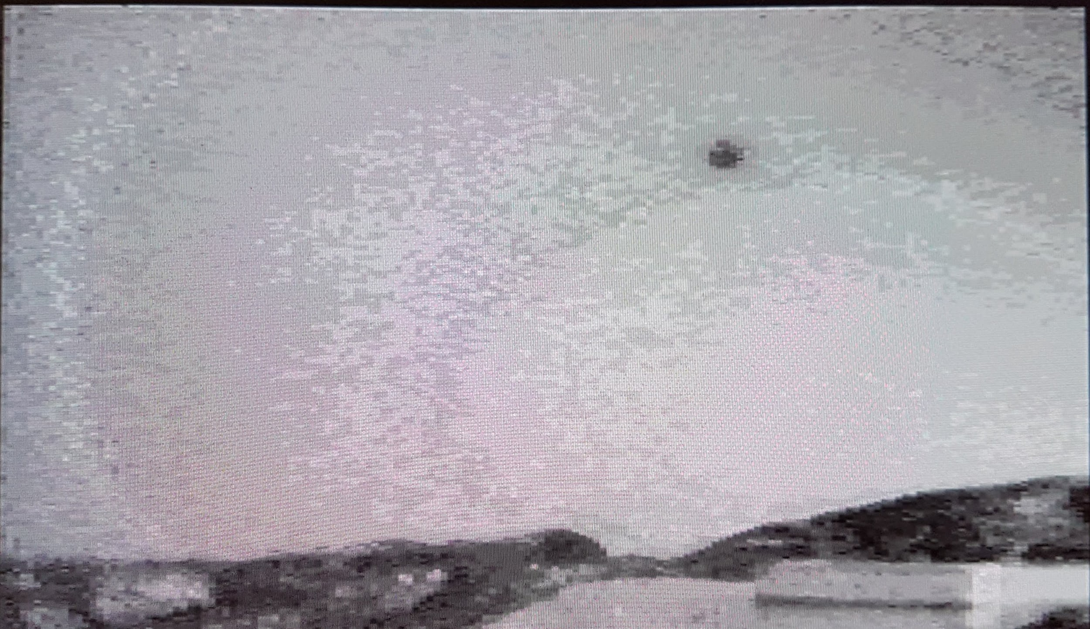
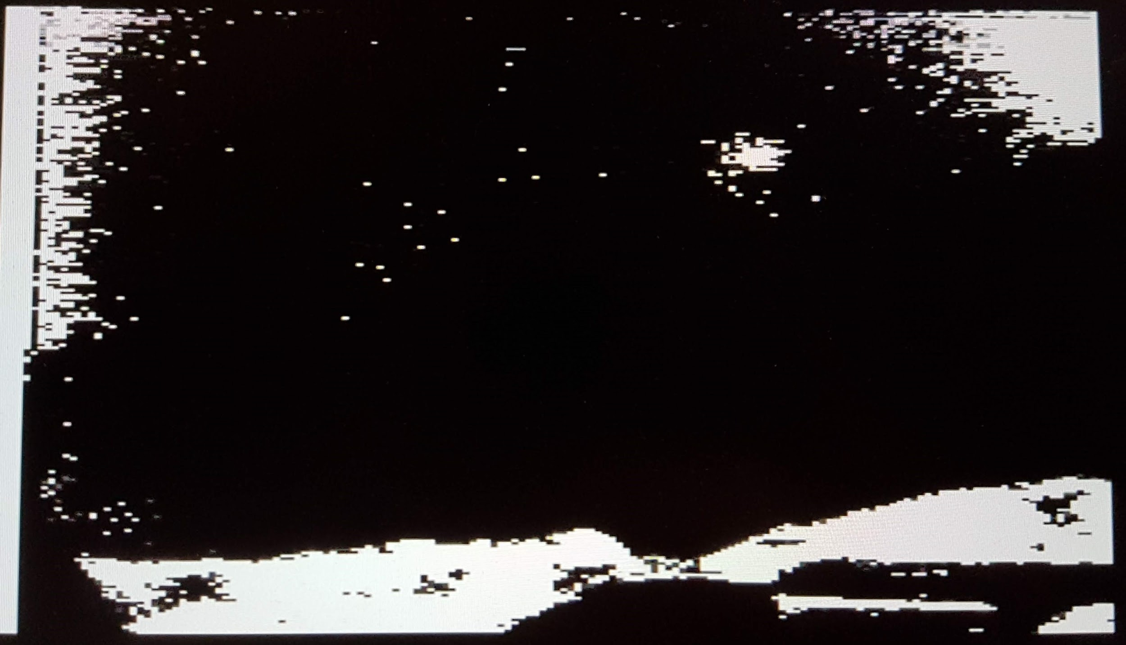
Mid-Project Demo
We demonstrated live camera stream thresholding via a VGA monitor. The thresholding value for black and white conversion was configurable via the Nexys 4 switches.
Grayscale Frame from Camera
Preprocessed Frame

Slide 8
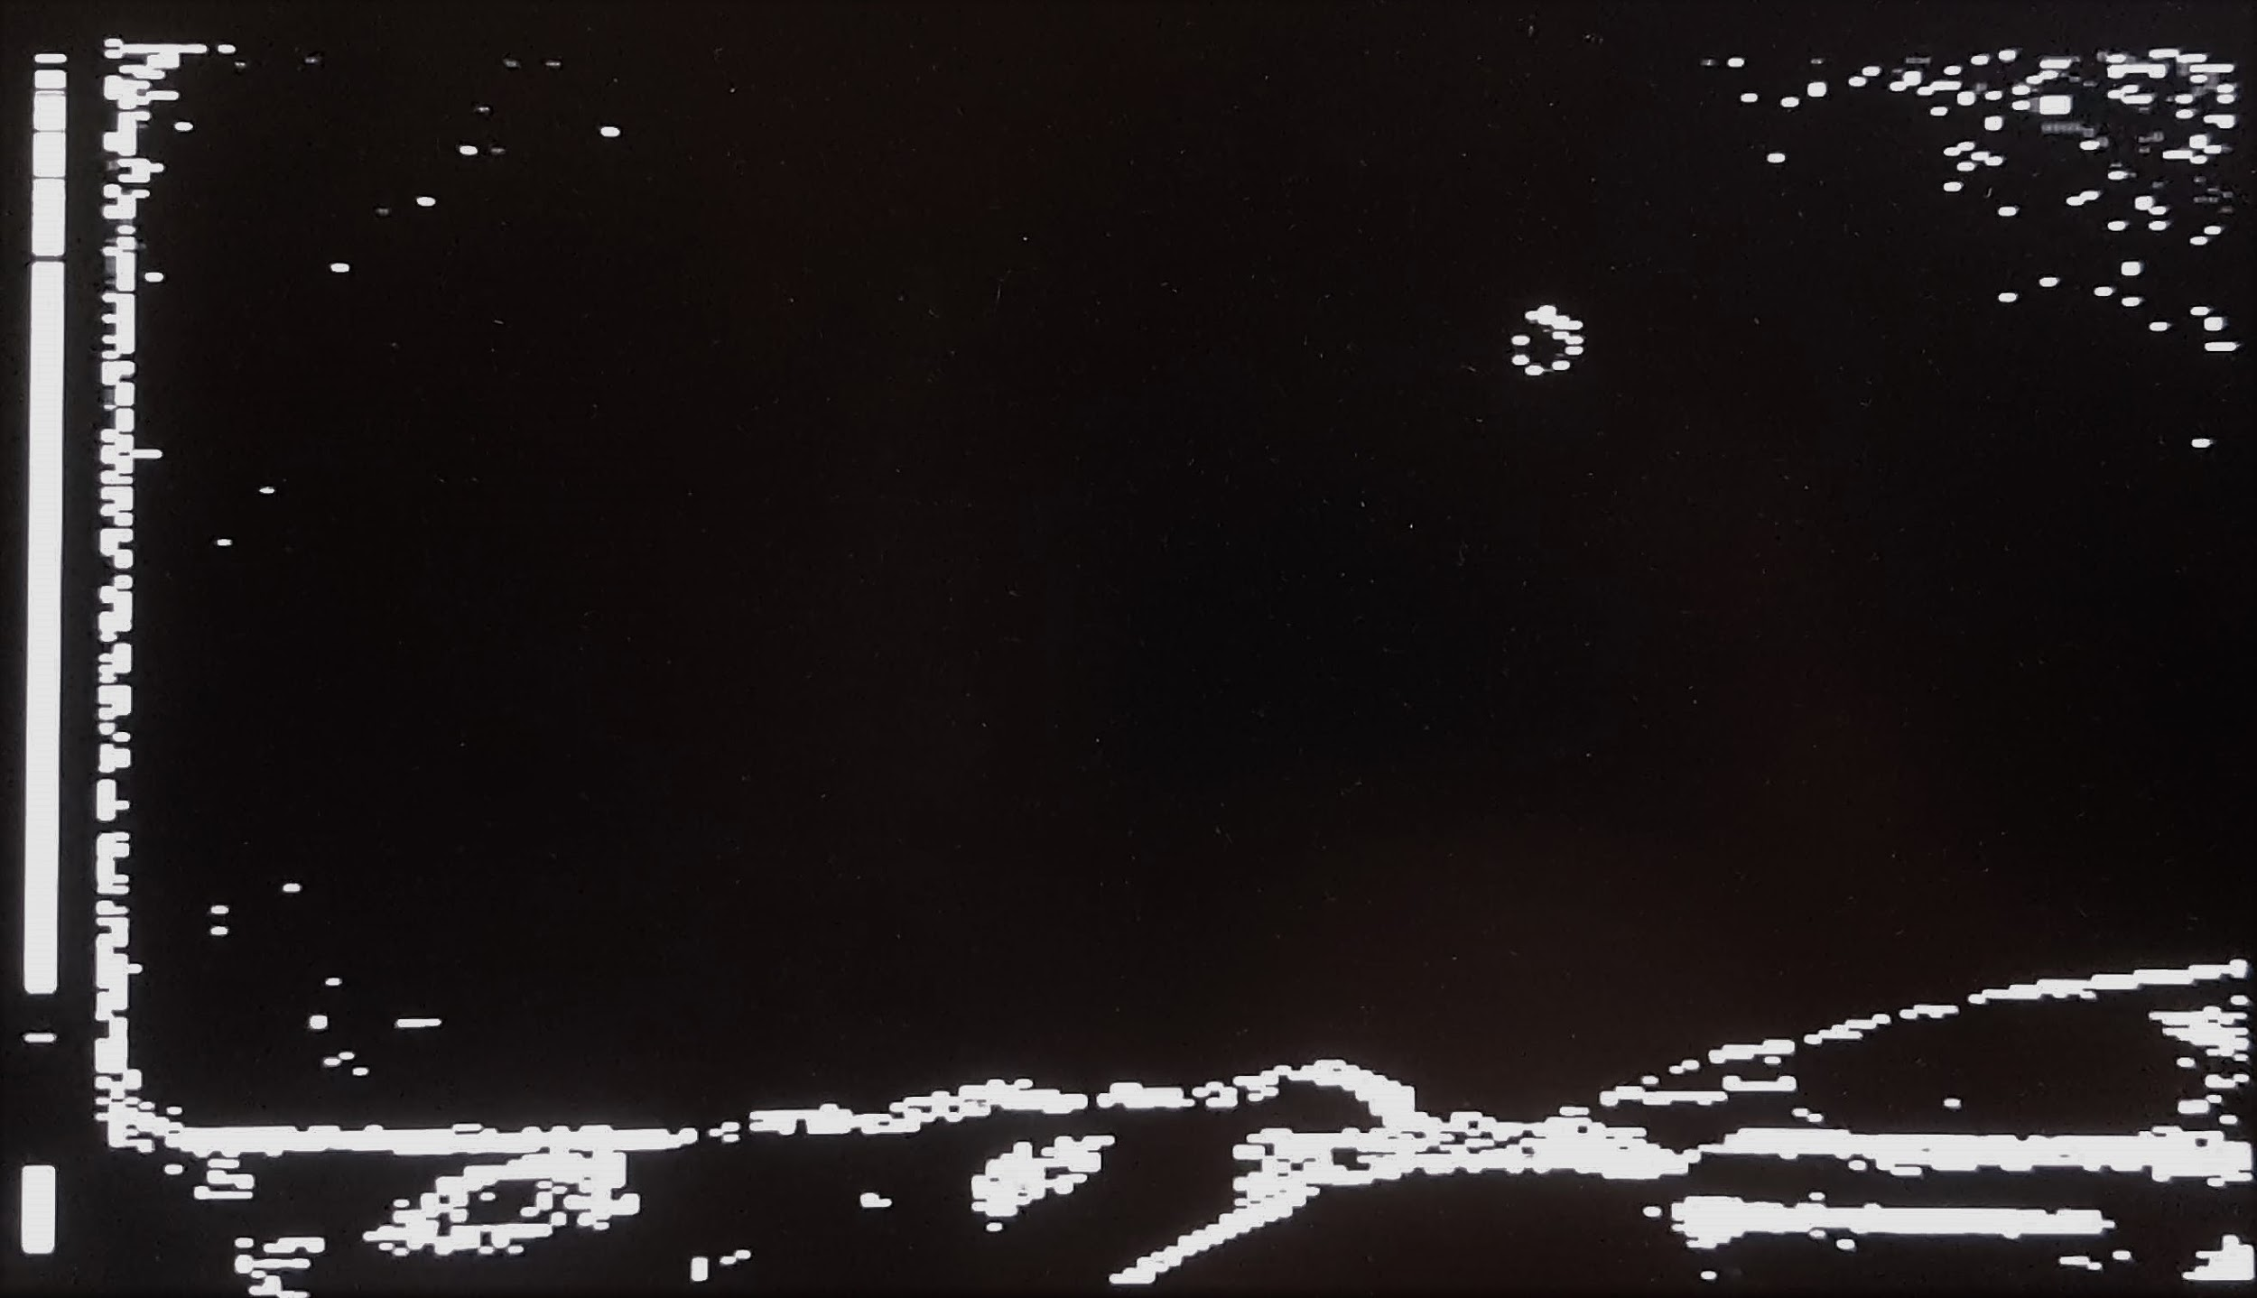
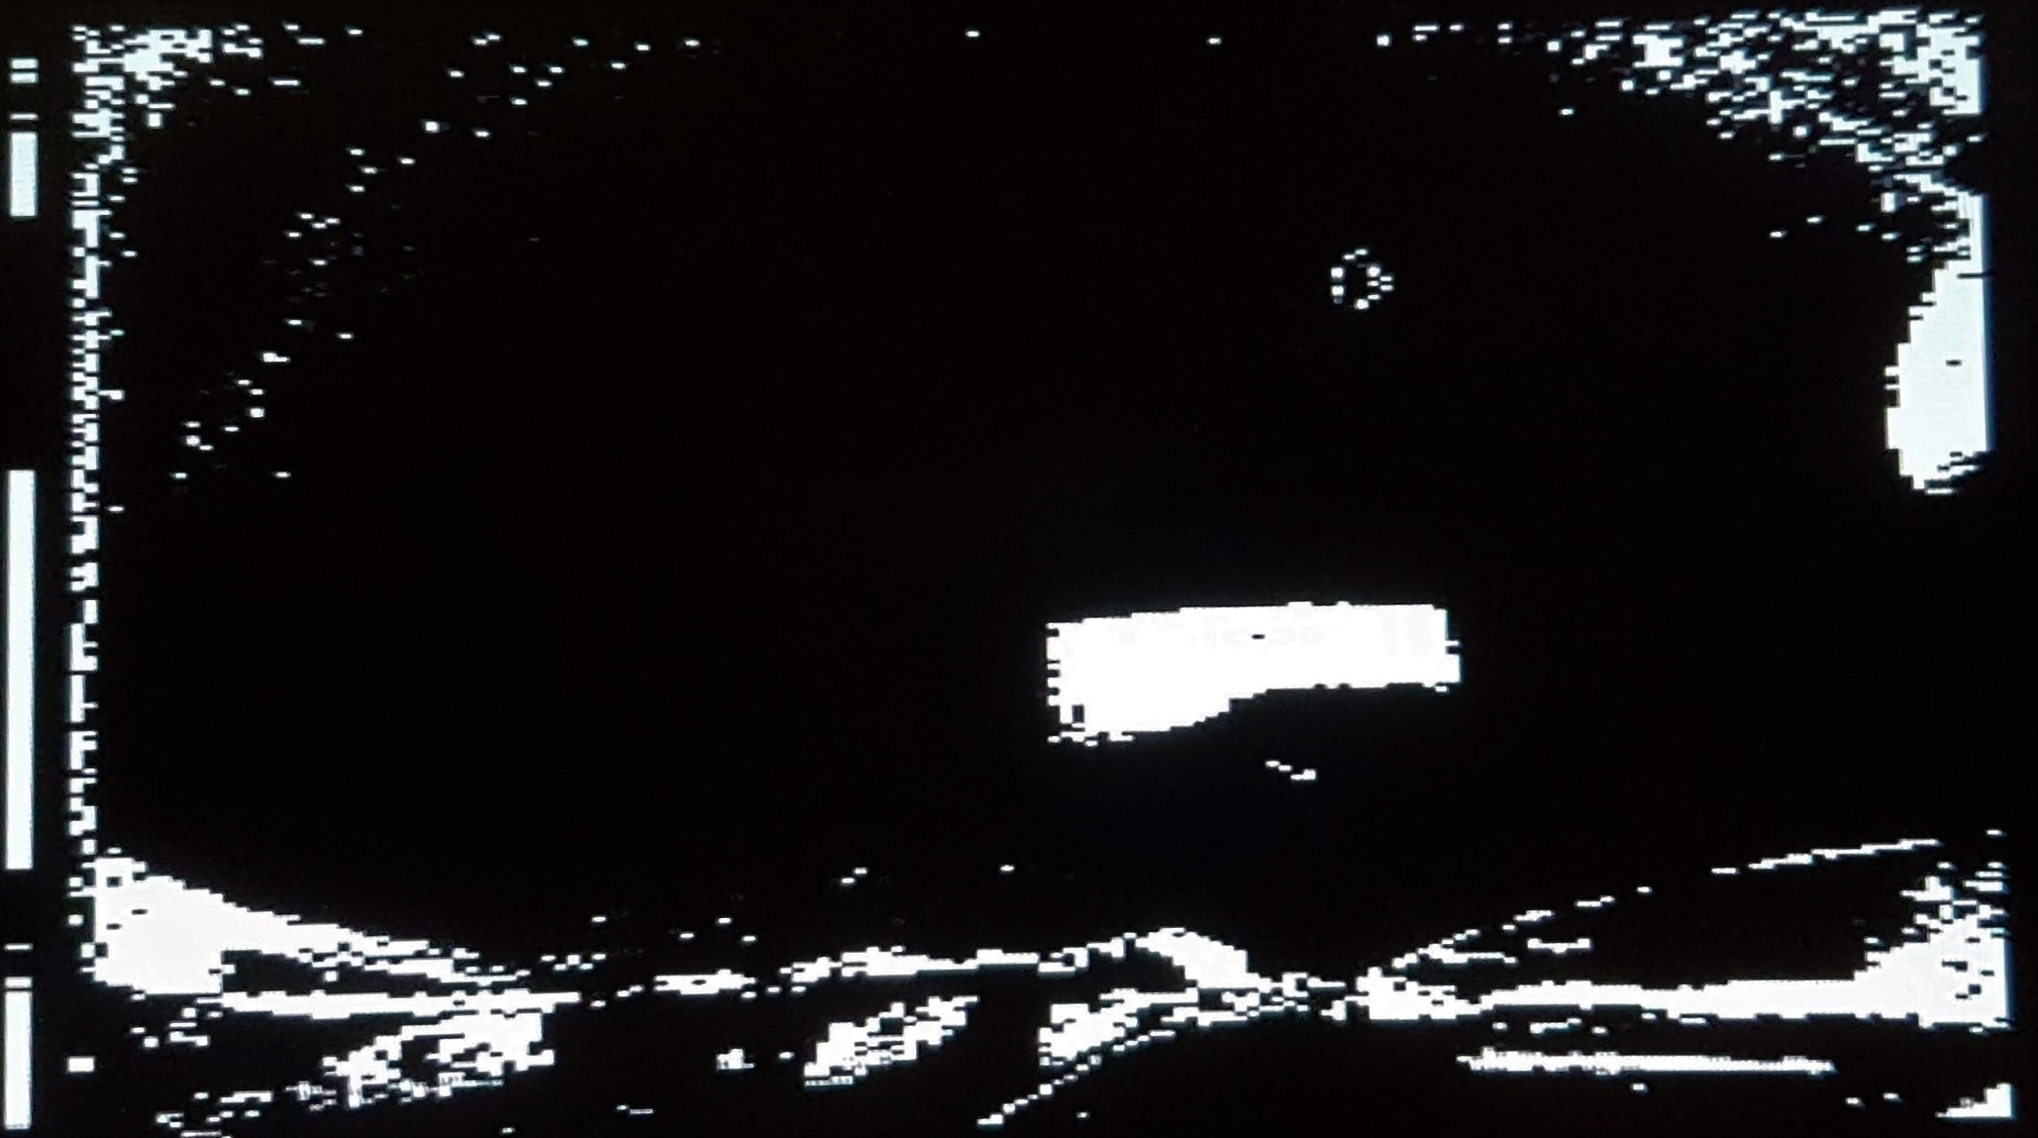
Mid-Project Demo
Since then, we’ve implemented the rest of the algorithm in hardware. The algorithm works in simulation, but needs further tuning to work in real-time on the board.
Difference Frame
Difference Frame with Foreign Object

Slide 9
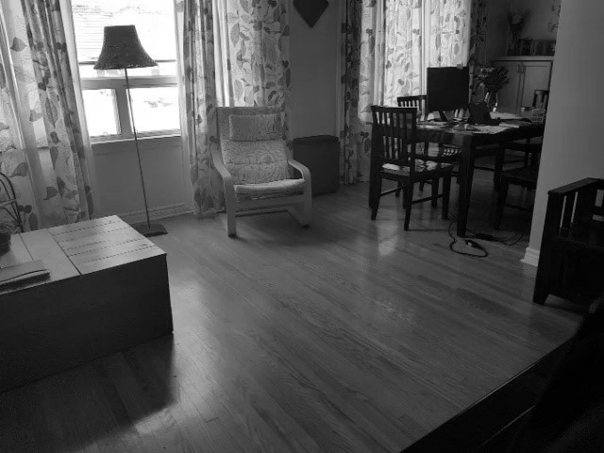
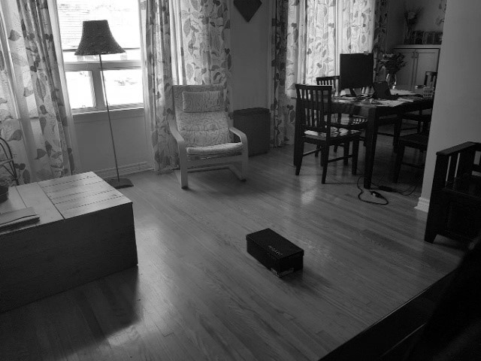
Comparison to Python Implementation
Grayscale Reference Frame
Grayscale Frame with Foreign Object

Slide 10
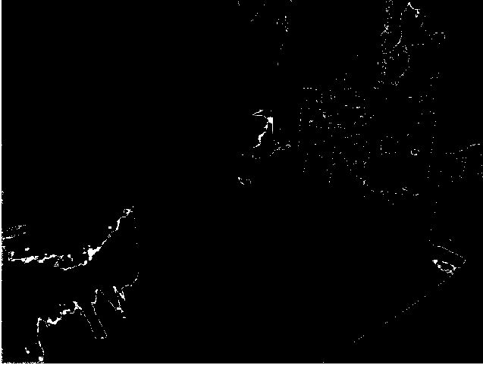
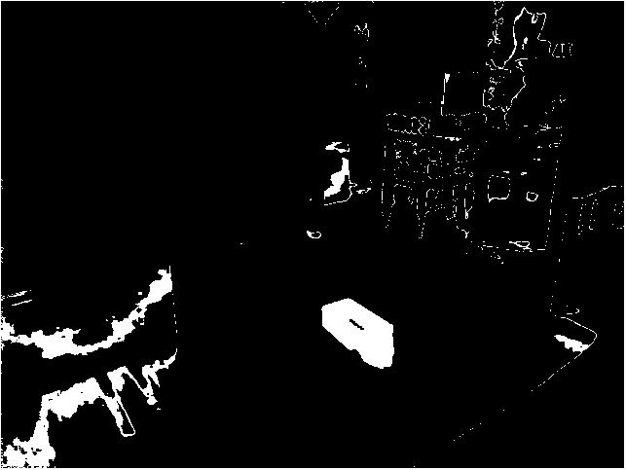
Comparison to Python Implementation
Difference Frame
Difference Frame with Foreign Object

Slide 11
Challenges Encountered
WiFi driver does not compile when using Vivado 2018.1
Caused by illegal struct organization
Solved by switching to Vivado 2017.4
GPS sensor is very “picky” about where it is located when obtaining a position fix
WiFi and GPS integration
There are conflicts between the WiFi and GPS interrupt configurations
Luckily, the GPS module can be manually polled for data which is sufficient for this project.
WiFi driver written in C++; GPS driver written in C and cannot be compiled using mb_g++
Solved by changing compilation settings and using extern “C” {}
PMOD Camera is highly susceptible to static noise, which was not accounted for when prototyping the algorithm in Python on VGA video taken from a smartphone
This will be mitigated by using a more extreme black/white threshold

Slide 12
Schedule & Outstanding Tasks
Outstanding Task | Planned Completion Date
Send image and GPS data package to server | March 21, 2019
Interrupt system to alert when software should initiate a broadcast | March 22, 2019
Integrate the DMA driver into the existing software architecture | March 23, 2019
Integrate Object Detection IP into existing block diagram and add interrupt generation when a suspicious object is detected | March 23, 2019

Slide 13
Questions?

